Slide 1


SAP UI5 & FIORI with OData TRAINING
Anubhav Oberoy & Nishan Nainsukha
Day – 6

Slide 2

Agenda
Sample SAP UI5 Application
Views in SAP UI5
Controller in SAP UI5
Basics of Controller
Introduction to XML View
Structure of XML
Introduction to Git

Slide 3

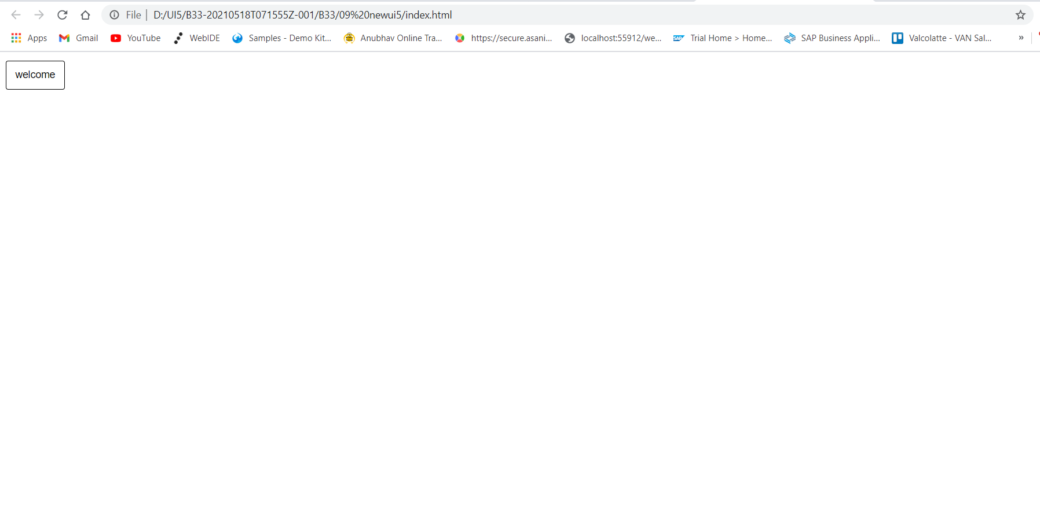
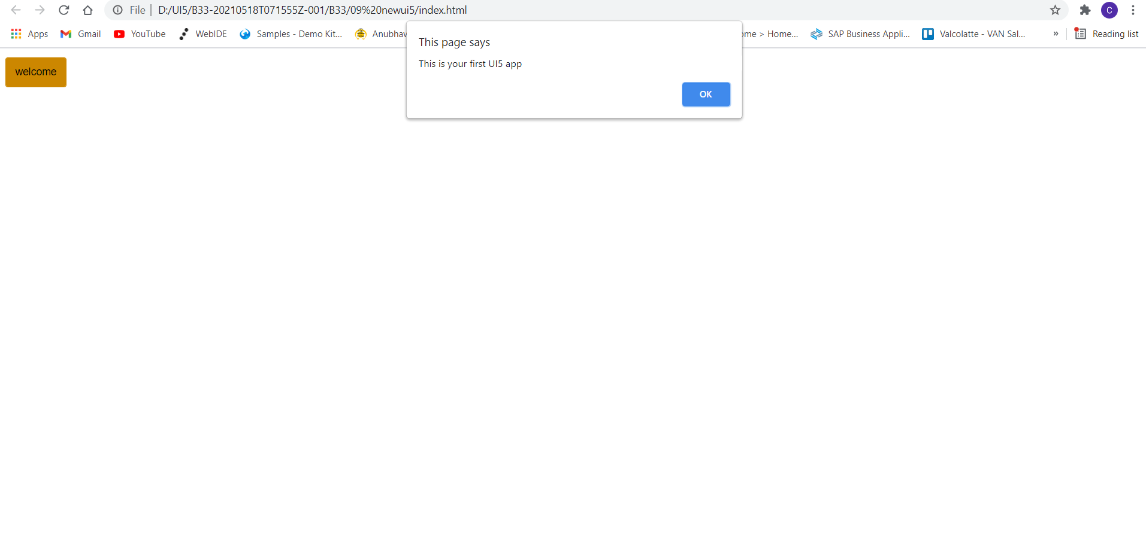
Sample SAP UI5 Application
Now we will make a sample UI5 application using index.html file.
In this application we are going to add a simple button provided in SAP UI5.
When the button is pressed it shows a alert popup at the top.
The application page looks similar to one which is shown below.
Code link:
index.html

Slide 4
Views in SAP UI5
A view can be any outputted representation of data, such as the front-end of your application or at a component level, a chart or diagram. The view will change according to changes in the model.
View is responsible to manage information display to the users.
Views are based on Model.
There are Four types of views in SAP UI5, these are listed below:
XML View:- It is in the XML format. The file name ends with the extension “.view.xml”. There are no predefined methods in the XML view.
JS View:- It is in JavaScript format. The extension of the view file is “.view.js”.
JSON View:- It is in JSON format. The file name ends with the extension “.view.json”.
HTML View:- It is in HTML format. The file name ends with the extension “.view.html”. Here we create the controls within the <div> tags, as we do while developing HTML pages.
Percentage Usage of Views:
2%
99%
JOSN View – 0%
HTML view – 0%
JS View is used only in 2% of the views.
XML Views are the mostly used views now a days.
The use of JSON and HTML views are negligible

Slide 5
Controller in SAP UI5
A controller contains methods that defines how models and views interact.
You define a simple controller as follows:
sap.ui.define([ "sap/ui/core/mvc/Controller" ],
function(Controller) {
"use strict";
return Controller.extend(“Address of Controller", {
// controller logic goes here
});
});
Special Class which inherits from standard SAP module called sap/ui/core/mvc/Controller
Skeleton of any JS file in SAP UI5 – Considered as a class
sap.ui.define([“dependencies”, “dep2”, “dep3”],
function(oD1, oD2, oD3) {
--logic—
}
);
Modules

Slide 6
Basics of Controller
For every Control if there is a property, we will have setter and getter methods for that property. For example, if there is a enabled property, we will have setEnabled and getEnabled methods.
To access the methods and properties of a UI Control, We cannot use the document object which is a plain HTML element object.
To obtain UI5 element object, we need to first get Application object,
sap.ui.getCore()
On top of App object, we can get UI5 element object and finally
byId(“just pass ID”)
we can call any methods of UI5
For every event in UI5, we have attachEvent, detachEvent, fireEvent methods as well, which can be used to link, delink and trigger event programmatically.
When we use JS view, inside the event handler, this pointer will point to the current control object not the class (controller) object. In order to force this pointer to work like our Controller object, we need to pass it explicitly. This ONLY applies in JS View.
Just now you showed getting view object from controller, this.getView(), Using this view object also can I get my control objects? Just to avoid sap.ui.getCore() – You can but in XML View
When we use XML views, the ID of the control will be viewId--controlId

Slide 7

Exercise 1
In this exercise we will create a js View.
Adding some buttons and input field in the view.
On Button press showing a alert popup
Exercise Code:
index.html
Main.controller.js
Main.view.js

Slide 8
Introduction to XML Views
What is XML?
XML stands for eXtensible Markup Language, it was originally developed to move data from one to another technology. It became popular to communicate between heterogeneous technologies.
XML is a tree data structure. Unlike HTML, we can use custom tags. Every programming language must support XML.
Portal
Java
App
ABAP
If_ixml
xml
xml
Data Objects → XML – Rendering
XML → Data Object - Parsing

Slide 9
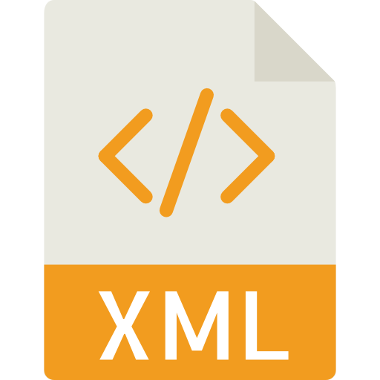
Structure of XML
<data>
<empStr>
<empId>5000</empId>
<empName>Jack</empName>
<salary>9500</salary>
<currency>EUR</currency>
</empStr>
<empTab>
<row>
….
</row>
</empTab>
</data>
Root Element
Child Element of <data> tag
Child Element of <empStr> tag
Skeleton of XML View
<core:View xmlns:core=“sap.ui.core” xmlns=“sap.m” controllerName=“pathOfContro.”>
<Button text=“Click Me”></Button>
</core:View>

Slide 10

Exercise 2
In this exercise we are going to create an xml view.
Adding a button and a form control in the view.
Exercise Code:-
MyXML.view.xml
MyXML.controller.js
Index.html

Slide 11
Push the code to Git Repository
Please follow the below GIT Commands to initialize and push the code in a Git Repository.
Initialization of Git
git init
git config --global user.email “your@example.com”
git config --global user.name “Your Username”
Set Remote Origin URL
git remote add origin https://github.com/user.name/RepoName.git
If already exists then use below command
git remote set-url origin https://github.com/user.name.RepoName.git
Staging the Changes of Project
git add .
Commit your changes
git commit –m “Initial Commit”
Push your changes into Git
git push origin master
Pull your latest changes for Git
git pull origin master

Slide 12

End of Day 6

Slide 13

Any Questions ?

Slide 14

Anubhav Oberoy

Slide 15
Title
Content

